Slide 1
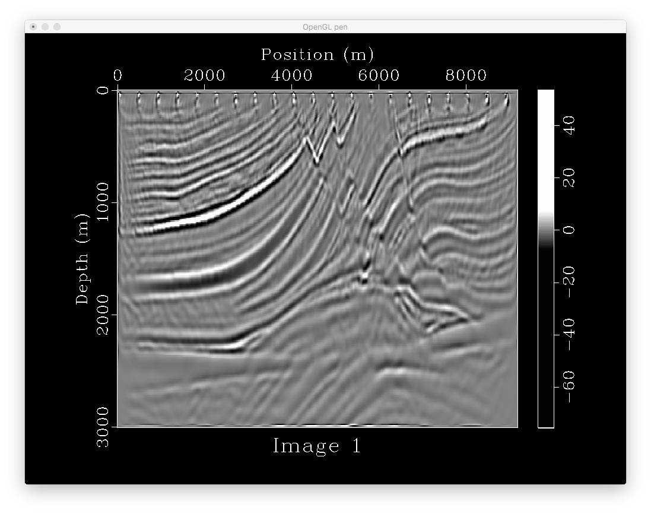
251*767
21 shots
0.0012*3000
with tpow

Slide 2
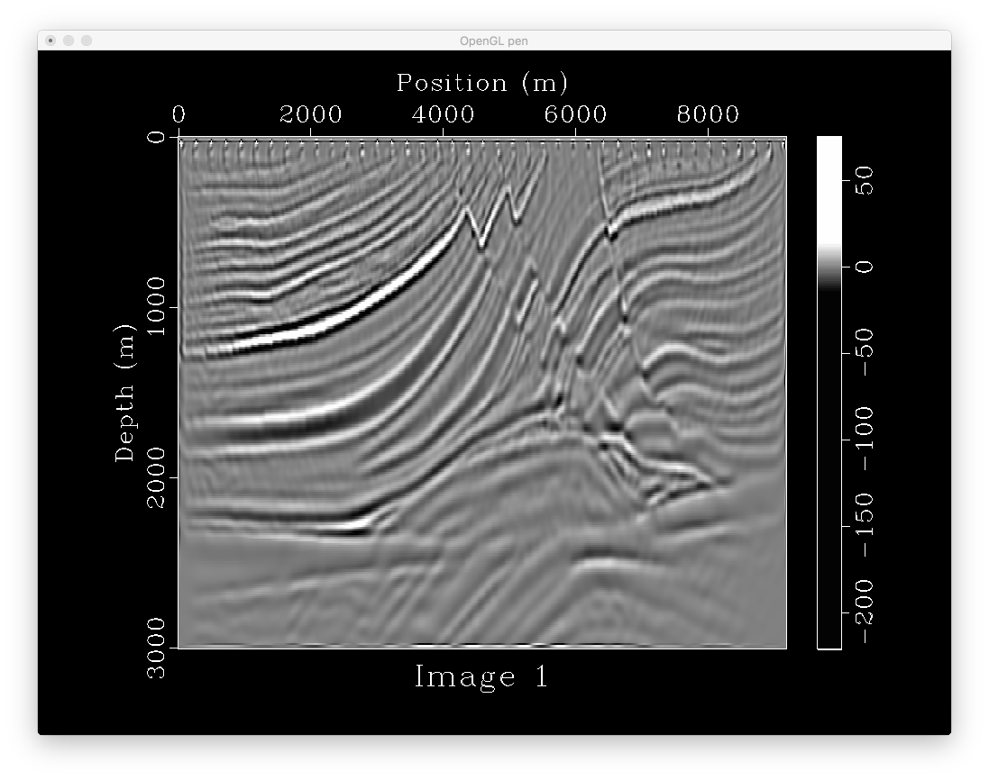
251*767
41 shots
0.0012*3000
with tpow

Slide 3

251*767
41 shots
0.0012*3800
with tpow
Longer time
record makes
no difference

Slide 4
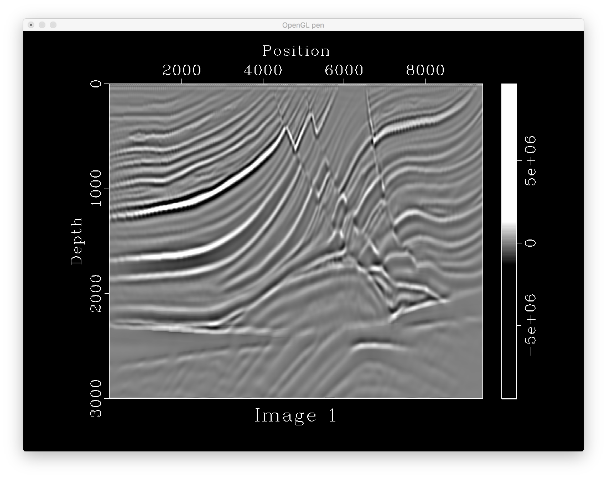
Full Scale
751*2301
200 shots
0.0002*18000
with tpow
With 55 extensions
On left and right
It is the currently
The best result

Slide 5
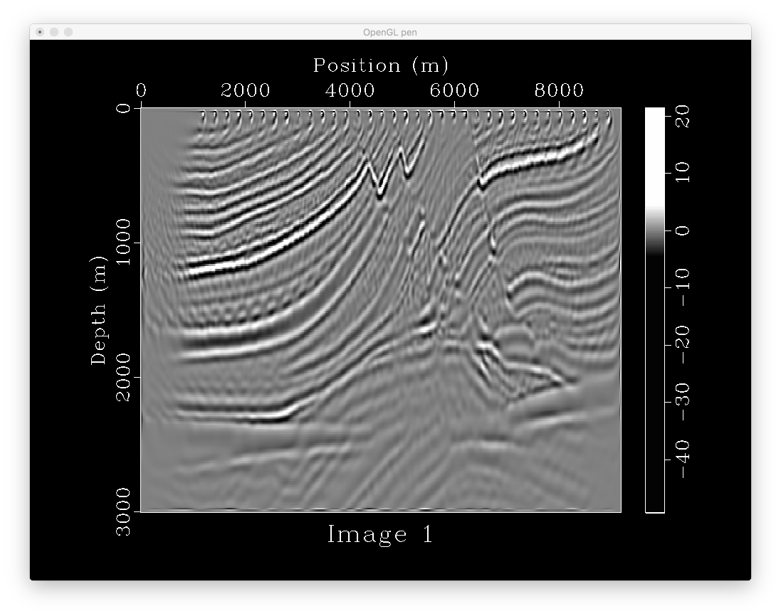
251*767
36 shots
0.0012*3000
Rolling acqusition
Ng=100
with tpow
Rolling shooting
Introduce acquisition
Footprint (window
Overlapping)

Slide 6
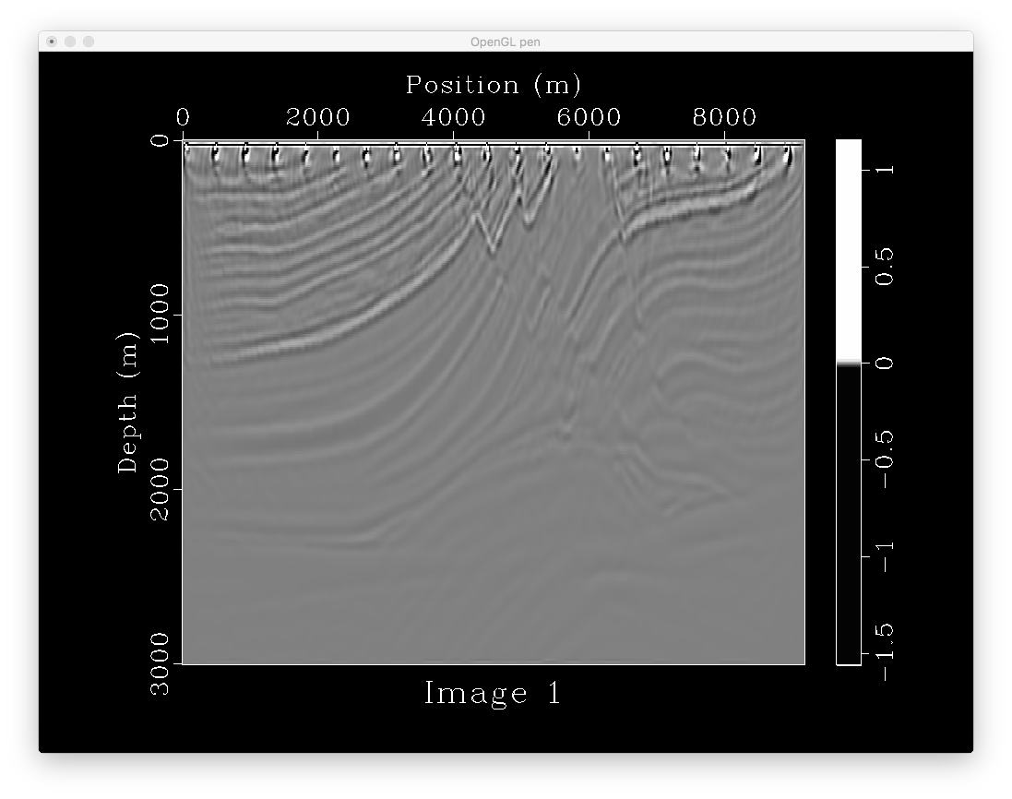
251*767
21 shots
0.0012*3000
without tpow

Slide 7
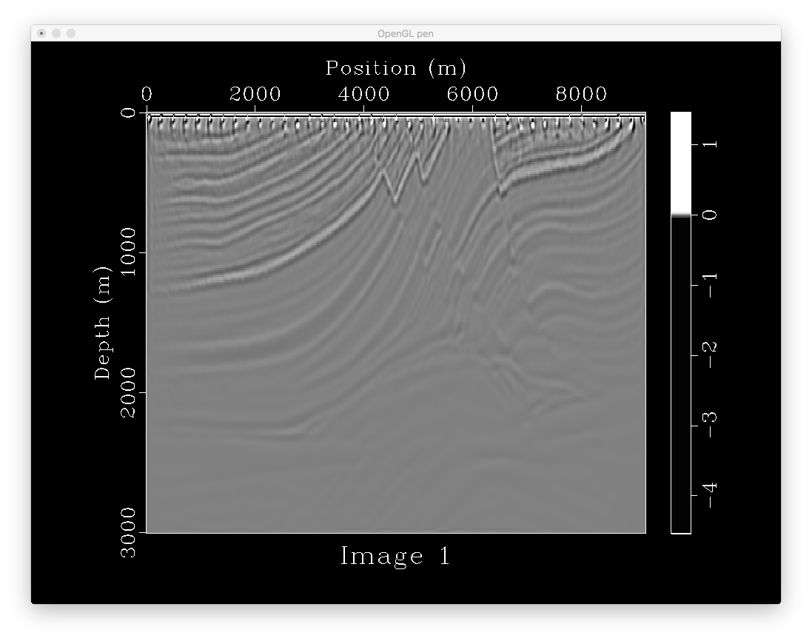
251*767
41 shots
0.0012*3000
without tpow

Slide 8
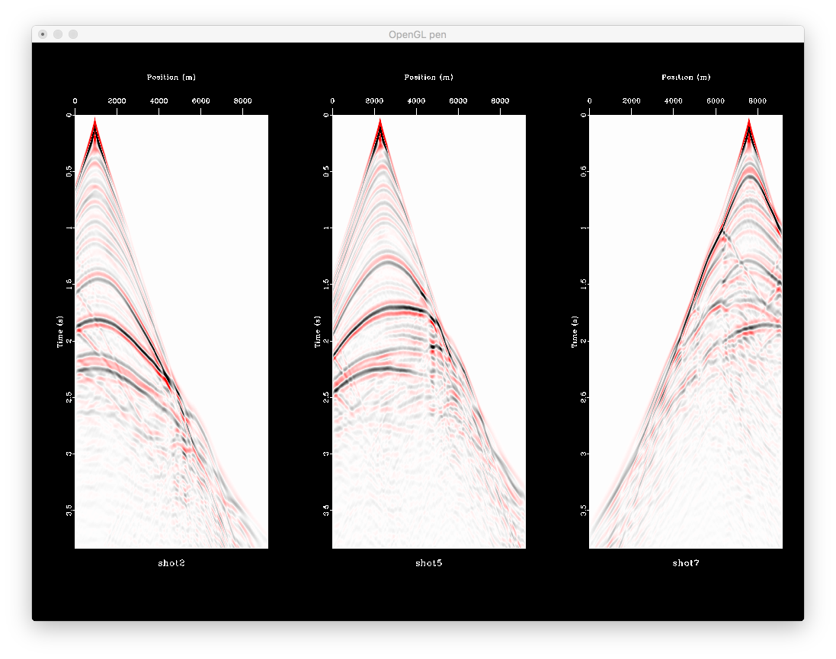

Slide 9
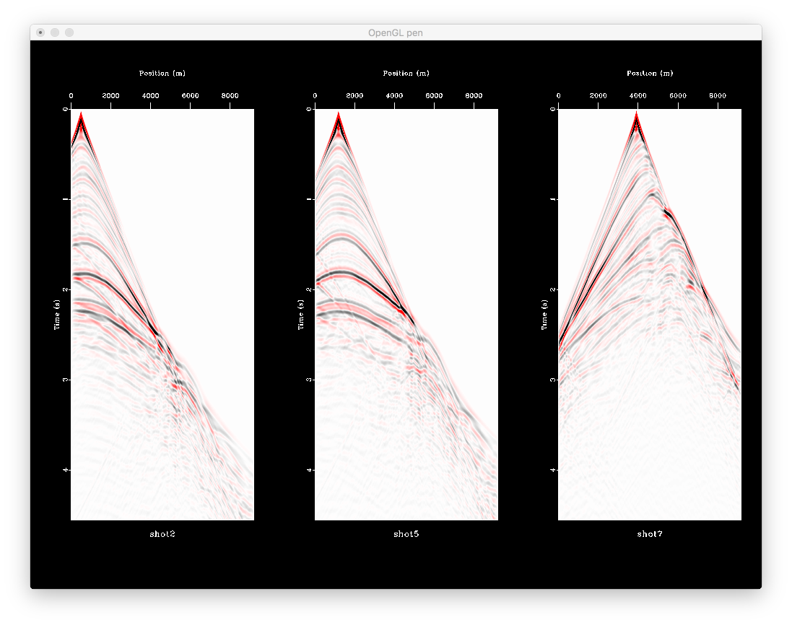

Slide 10
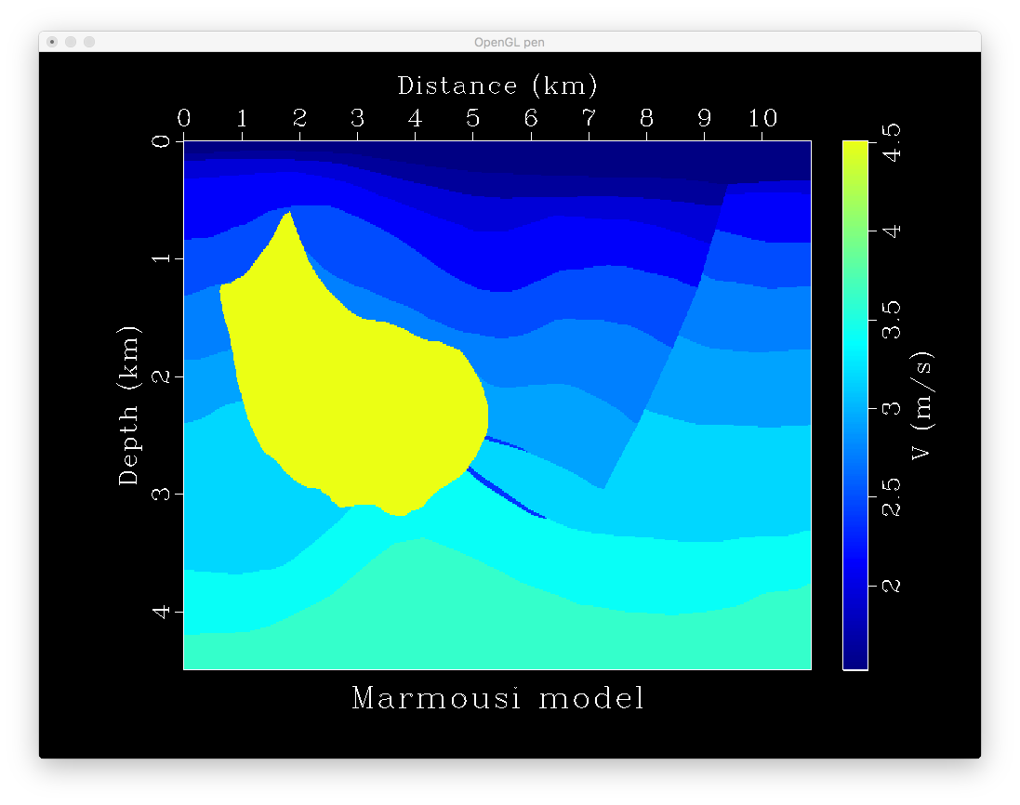

Slide 11
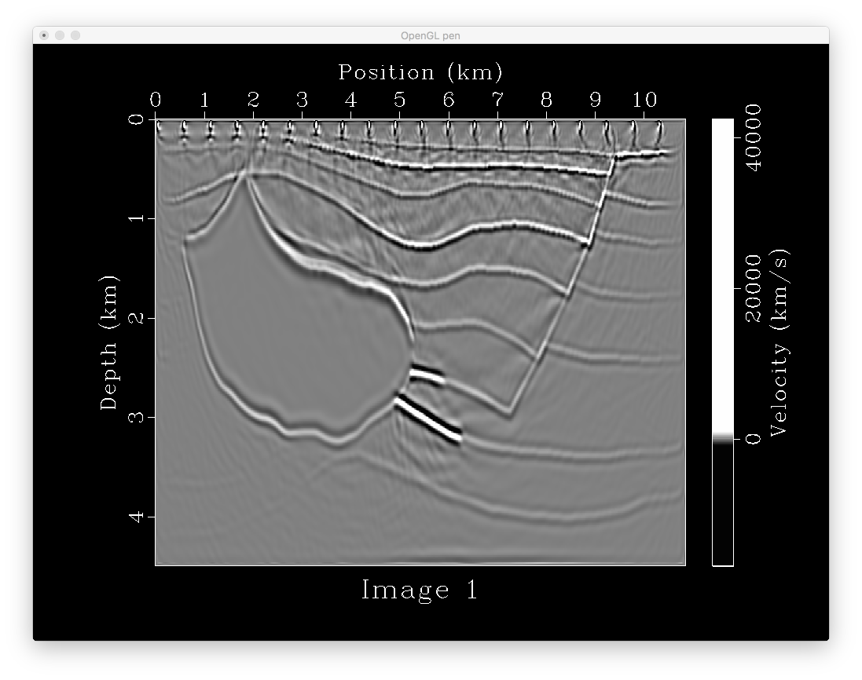
375*905
21 shots
0.0015*4000
with tpow

Slide 12

375*905
61 shots
0.0015*4000
with tpow

Slide 13

375*905
87 shots
0.0015*4000
with tpow
With left and
Right extension

Slide 14

375*905
87 shots
0.0015*4000
with tpow
With left and
Right extension
original size

Slide 15
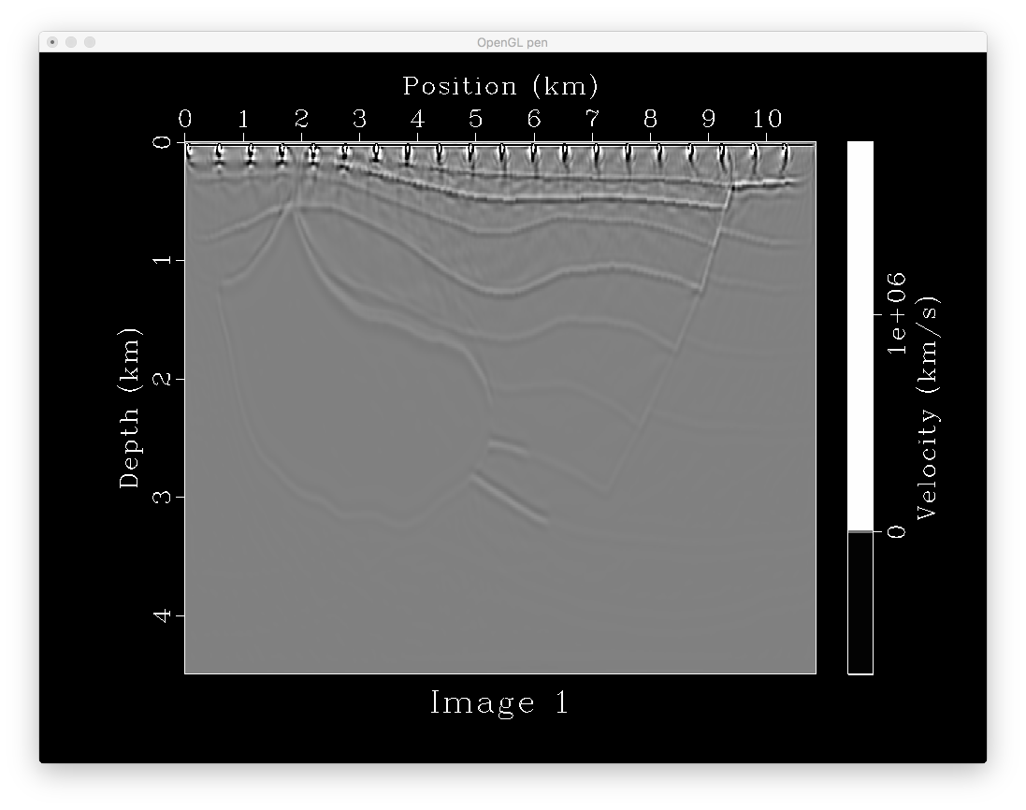
375*905
21 shots
0.0015*4000
without tpow

Slide 16

375*905
61 shots
0.0015*4000
without tpow

Slide 17
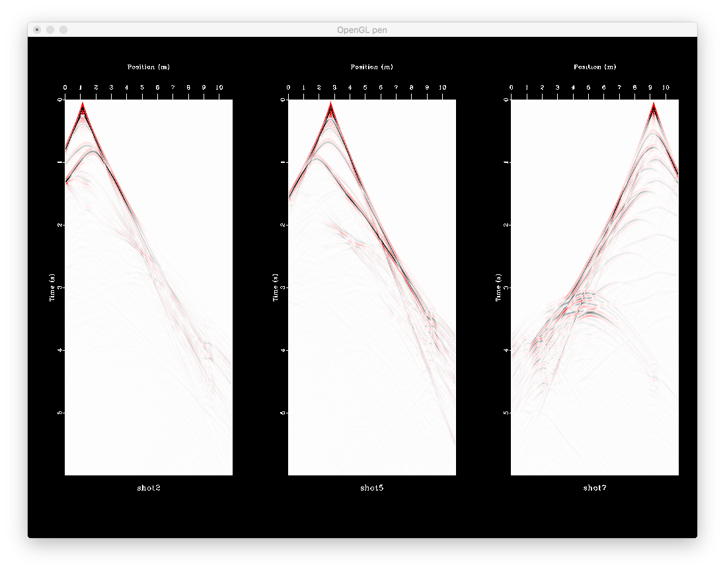

Slide 18
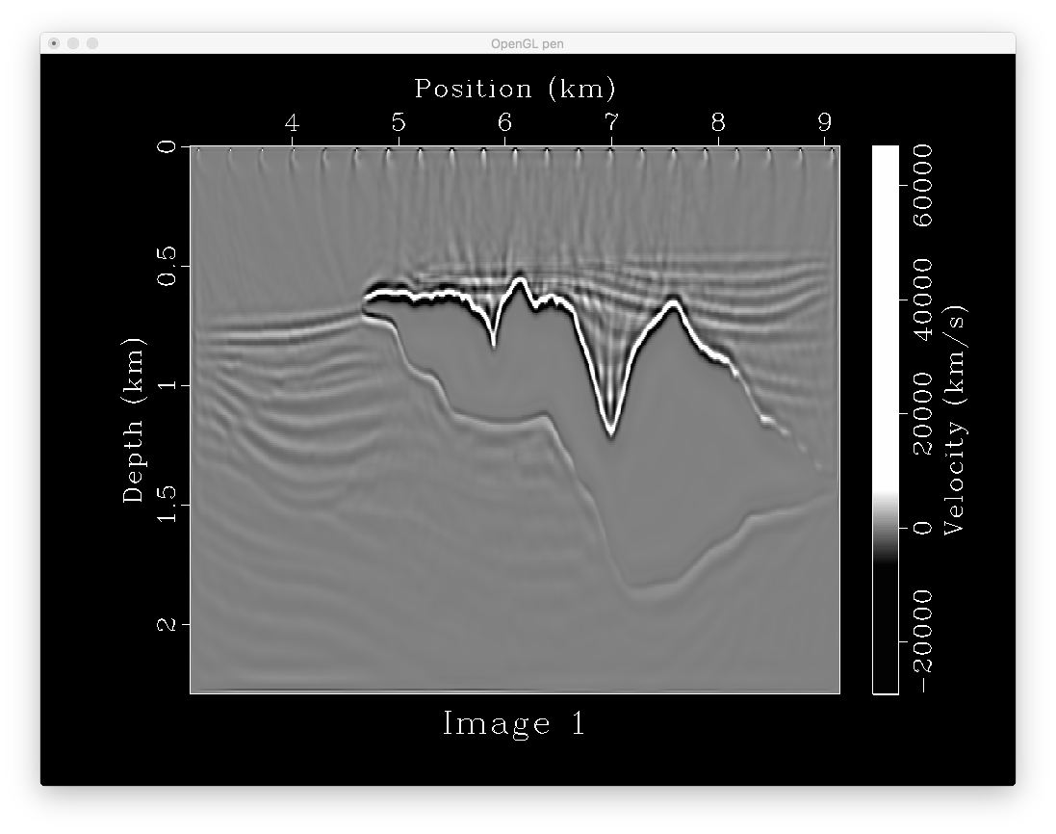
301*801
21 shots
0.0015*4000
with tpow

Slide 19
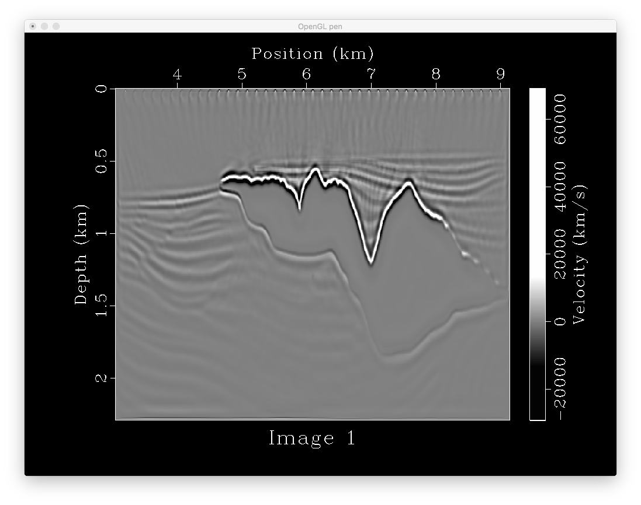
301*801
41 shots
0.0015*4000
with tpow

Slide 20
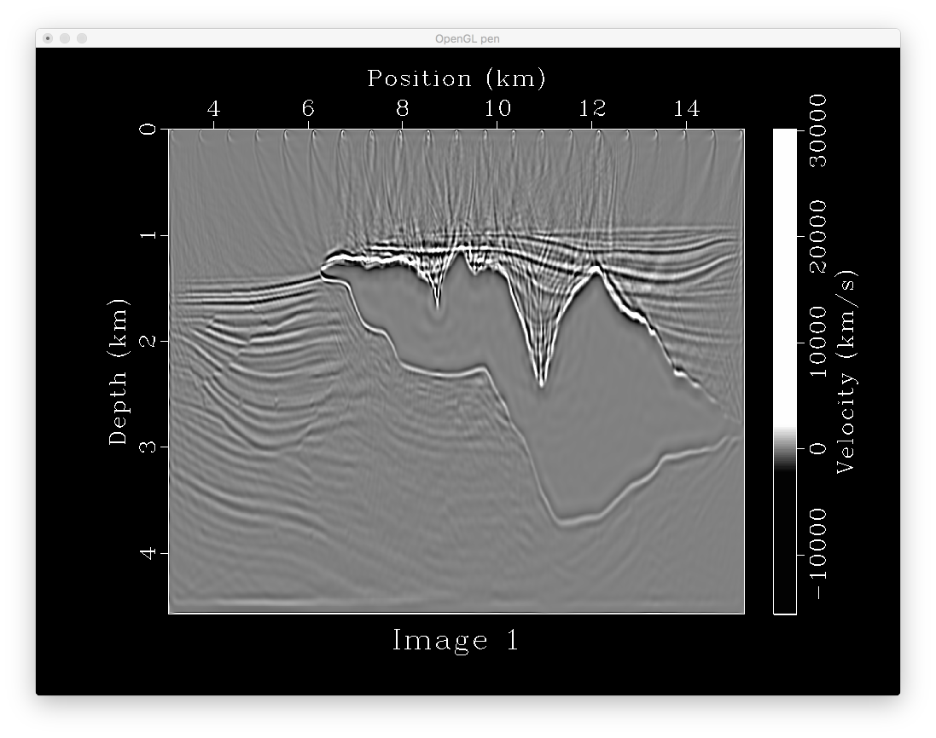
601*1601
21 shots
0.001*10000
with tpow

Slide 21
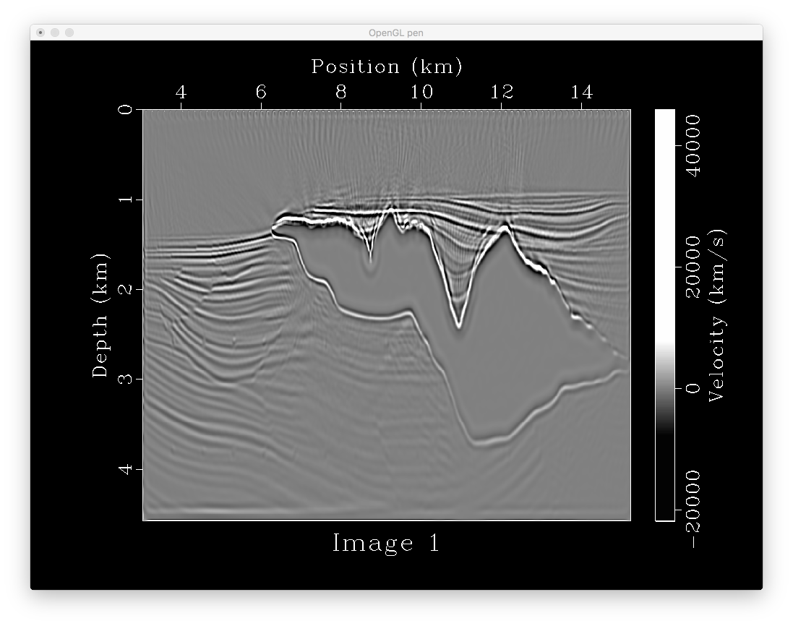
601*1601
80 shots
0.001*10000
with tpow

Slide 22
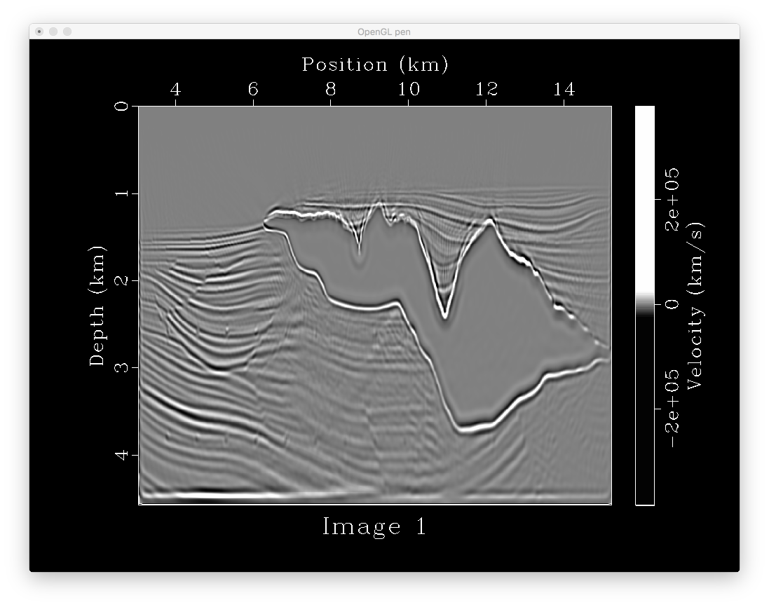
601*1601
80 shots
0.001*10000
with larger tpow

Slide 23
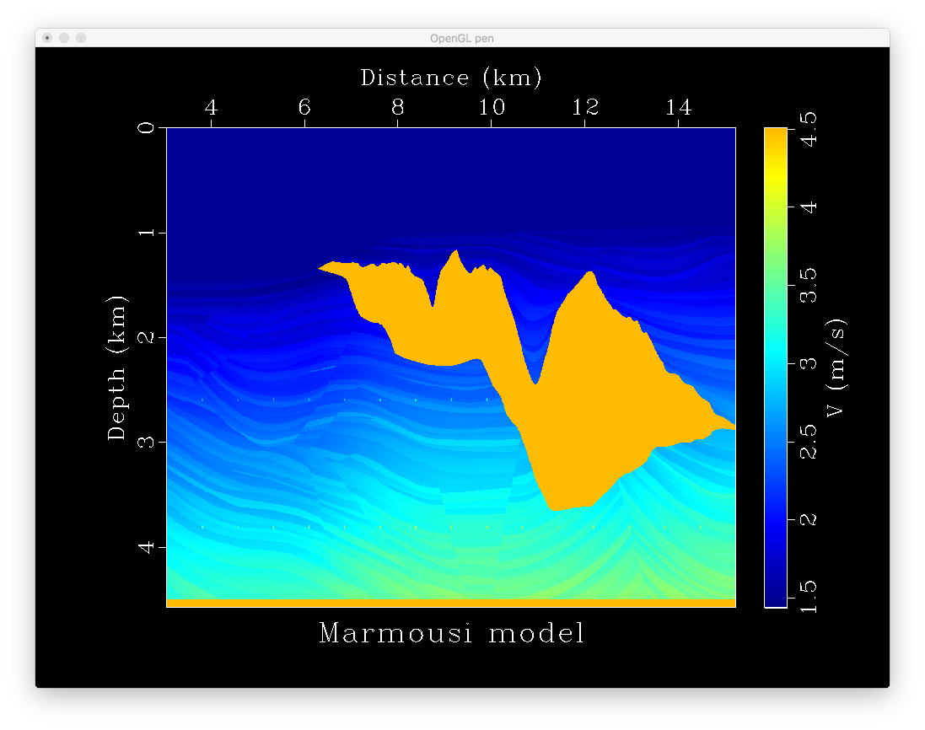

Slide 24

301*801
41 shots
0.0015*4000
without tpow

Slide 25
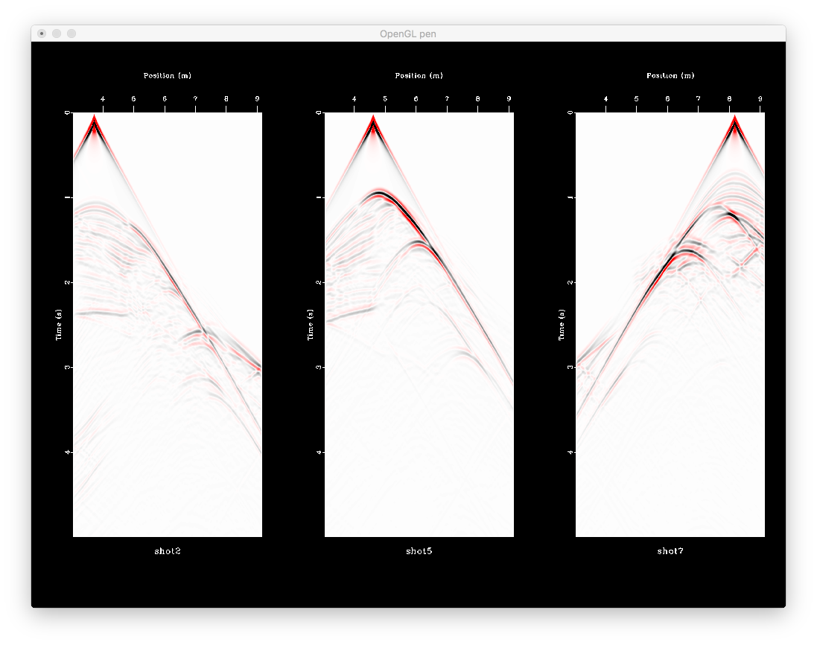

Slide 26
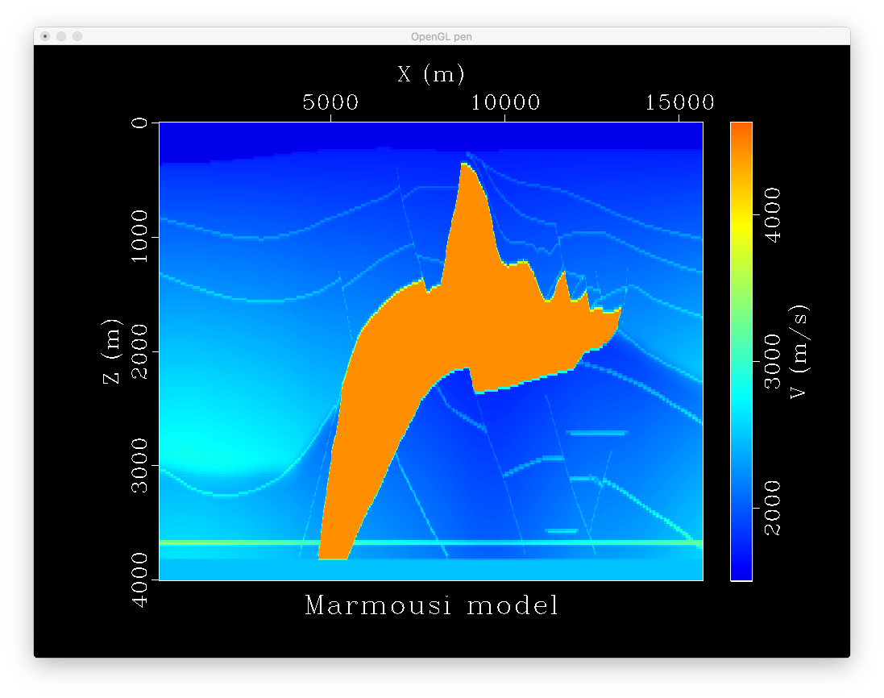

Slide 27
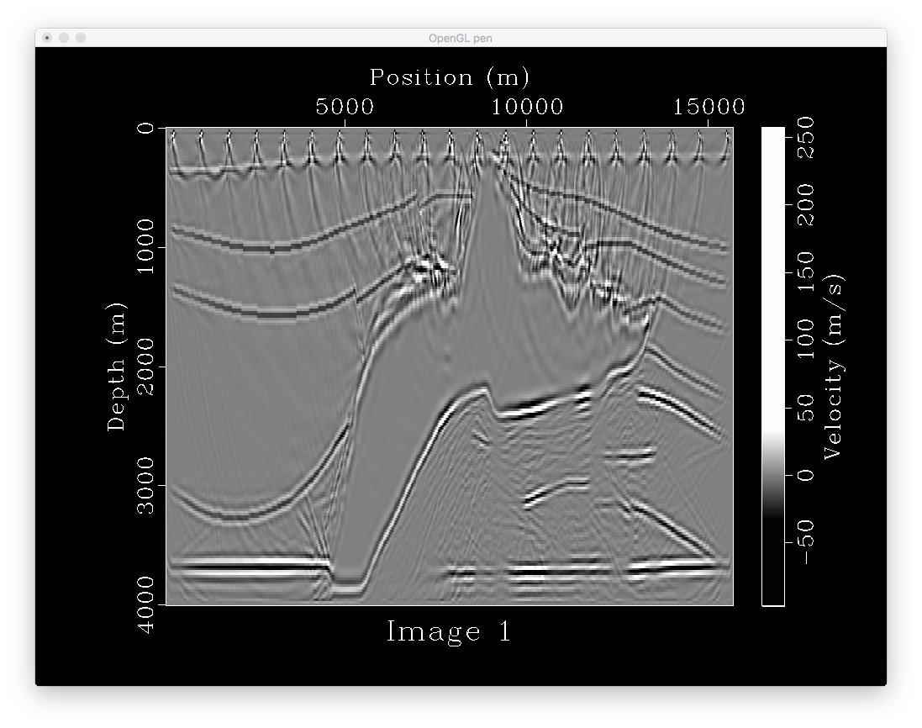
201*780
21 shots
0.0015*4000
with tpow

Slide 28
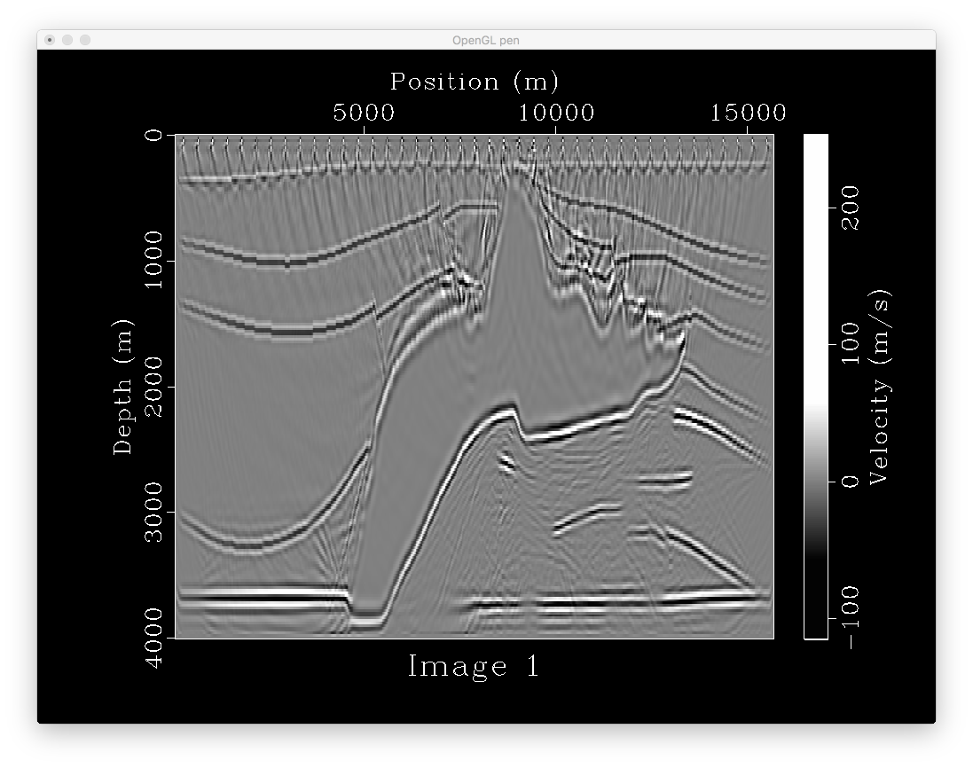
201*780
41 shots
0.0015*4000
with tpow

Slide 29
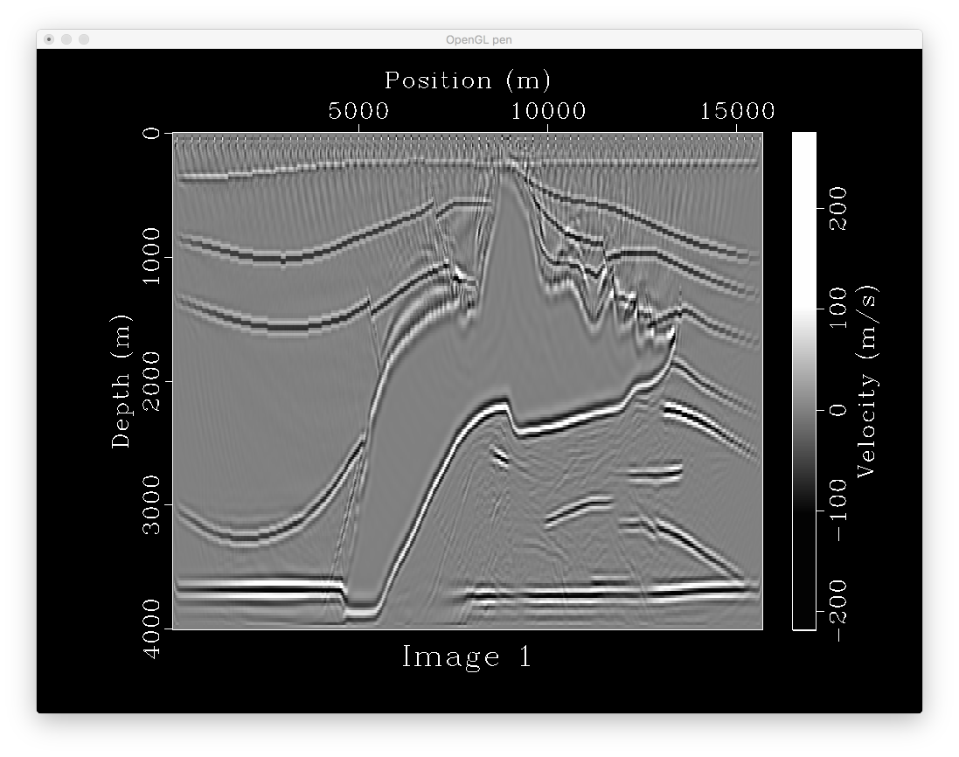
201*780
78 shots
0.0015*4000
with tpow

Slide 30
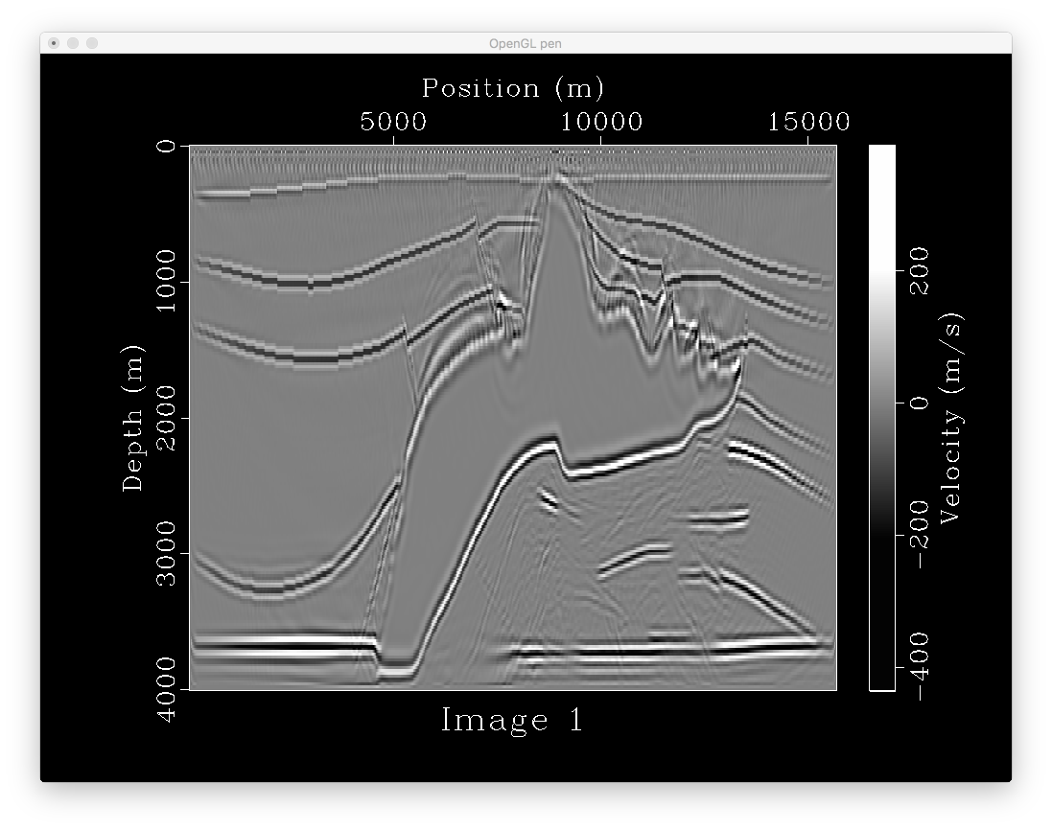
201*780
155 shots
0.0015*4000
with tpow

Slide 32
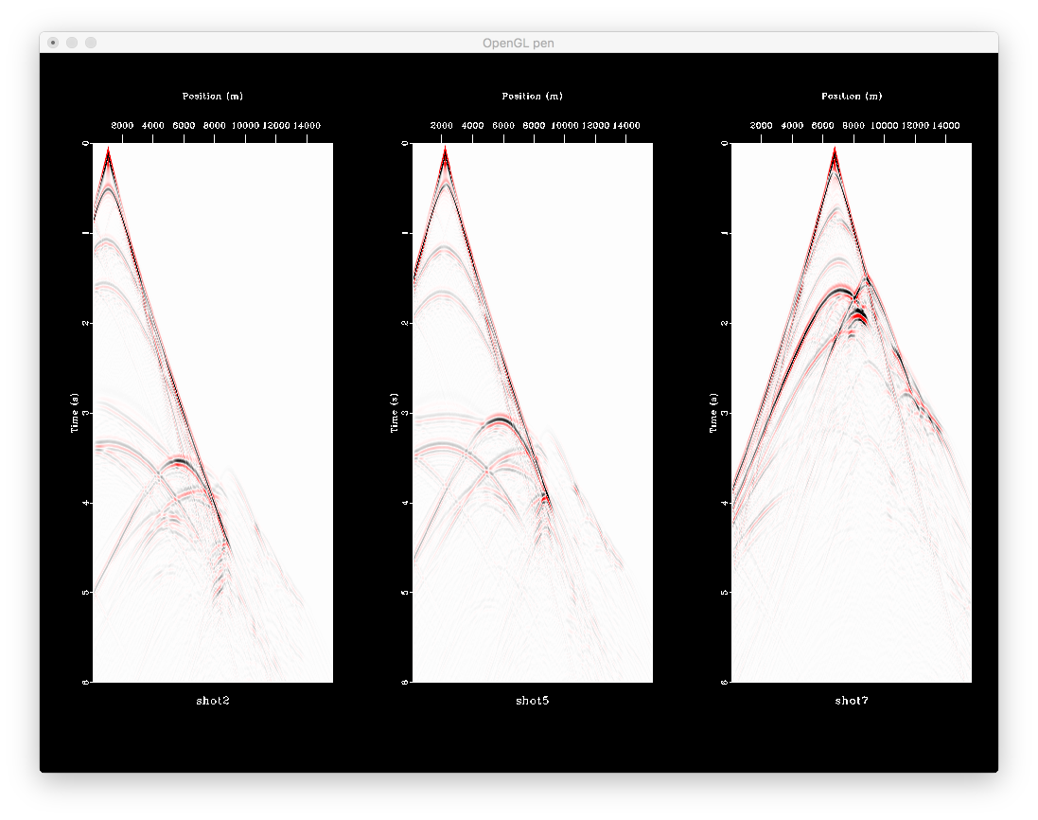

Slide 33
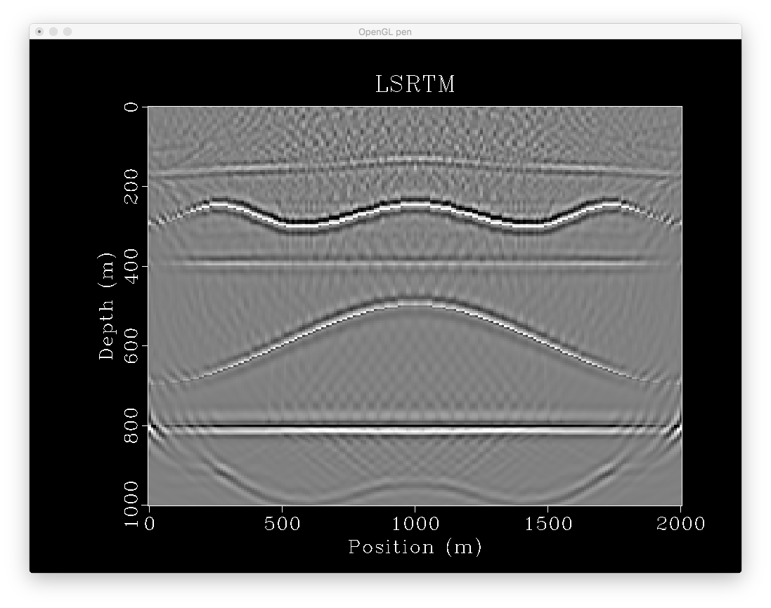
Boundary effect
Causes artifacts
On top and bottom
Of the image

